Slide 1
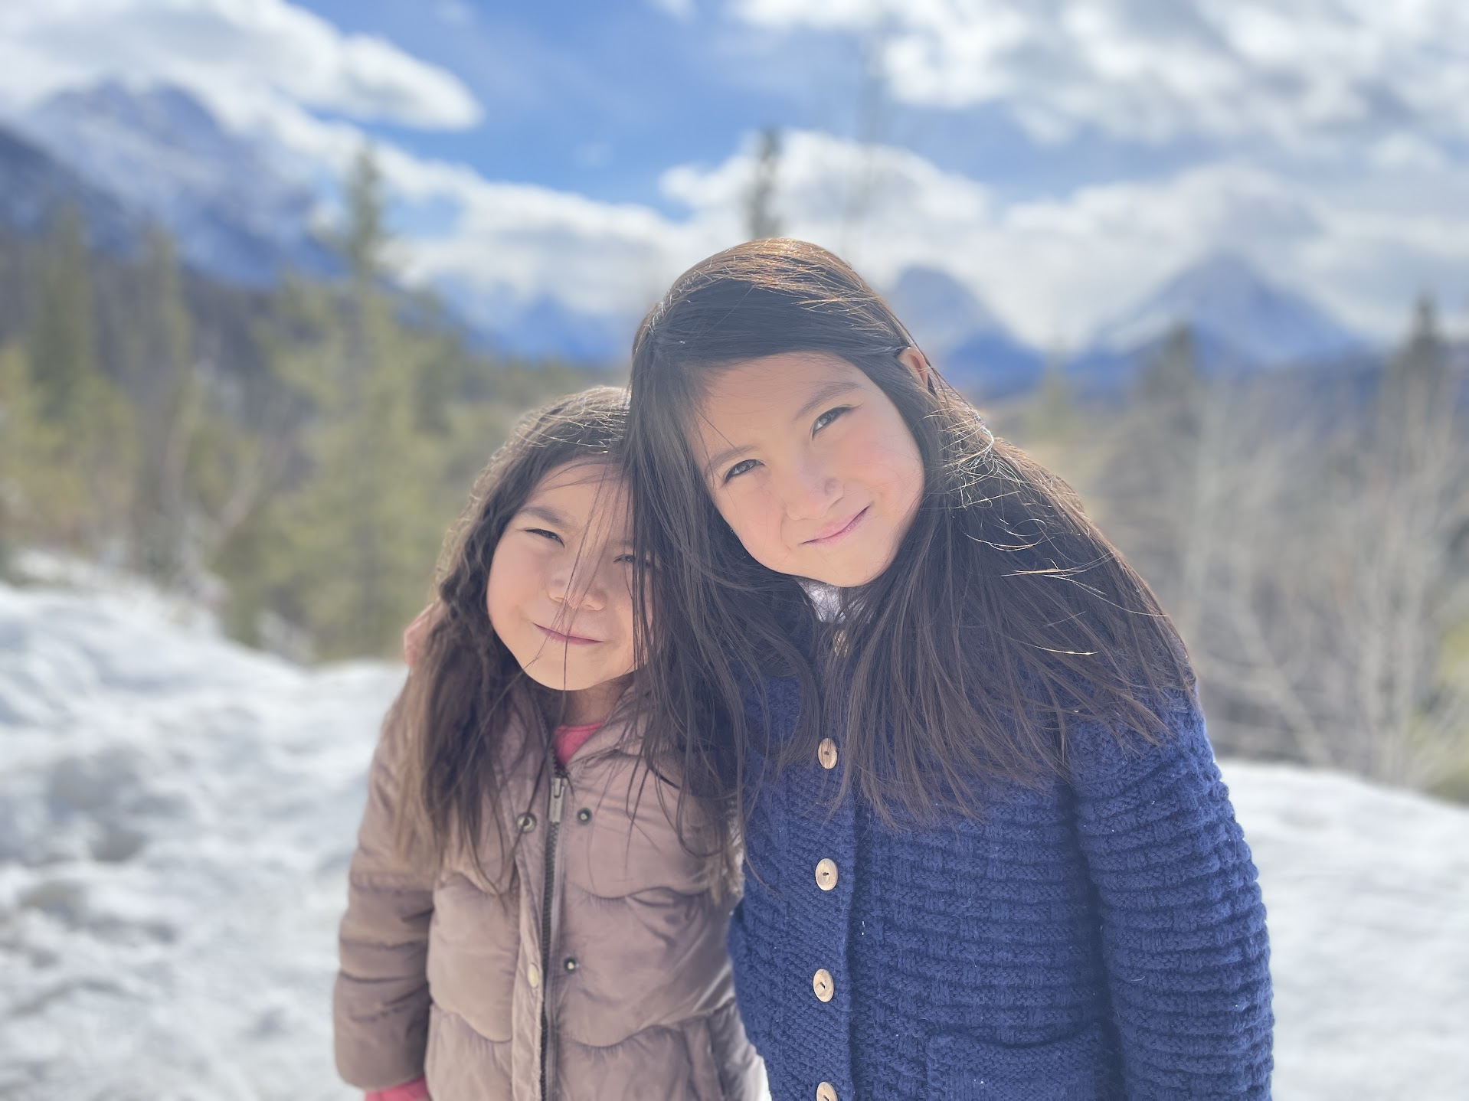
Conversation Club Nov 1st
Today’s topic is about?

Slide 2
Family!
Can you share a funny story about your family

Slide 3
Family!
What is your favorite childhood memory?

Slide 4
Family! What DIFFERENCES AND similarities DO YOU SEE BETWEEN FAMILES HERE AND YOUR HOME COUNTRY?

Slide 5
Family!
Poll Question
Why is your family important to you?
Because I love them
I get money from them
They always clean my room for me
They always give me great gifts

Slide 6
Poll Question
When is the best time to give gifts for a family member?
Christmas
Birthdays
Mother’s Day
Father’s Day

Slide 7
Game #1: Create A funny Story You and your brother/sister go out to dinner. You get into an argument and one of you walks out and lays down in the middle of traffic. Everyone immediately rushes outside to see what is happening. As you are arguing, a marching band, an elephant, and a bus full of tourists stop to see what is happening. …….. At the End, everyone was hugging, dancing and throwing water balloons to people walking by. It was a fun time had by all.

Slide 8
Game #1: Create a Funny Story You and your brother/sister go out to dinner. You get into an argument and one of you walks out and lays down in the middle of traffic. Everyone immediately rushes outside to see what is happening. As you are arguing, a marching band, an elephant, and a bus full of tourists stop to see what is happening. The people from the Bus where from a local karate club. They decided to then practise karate while the band played a song which then caused the elephant to sing along. At the End, everyone was hugging, dancing and throwing water balloons to people walking by. It was a fun time had by all.

Slide 9
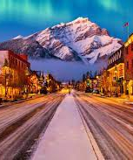
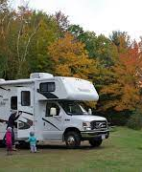
Game #2: Get to the Airport
“ You and your family have decided to visit Banff, Canada. Your family has rented an RV. You are also bringing along your pets, Charlie, the Chimpanzee who plays the violin and can drive, Stripes, the Zebra who can whistle and smoke cigars and Gerry the Giraffe who sings. You and your family have run out of money and need to get back to the airport. Create a funny on how you would get back to the airport on time.

Slide 10
Game #2: Get to the airport
For example:
My family and our pets have decided to start a musical band. As I knew how to play the drums, we decided to set up near a farmers' market in Banff. We set up a donation bucket for this and before long, we had enough money to get back in time, but also upgrade all of us to First class.

Slide 11
Exit Ticket: What was the most important thing you learned in today's class?

