Slide 1
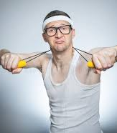
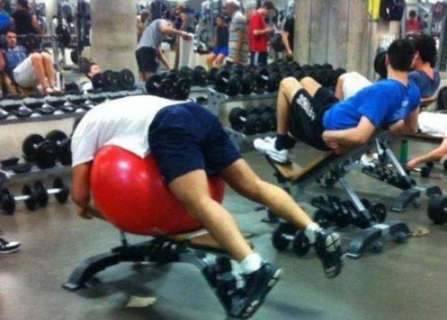
Conversation club Nov 8th, 7:30 pm
TESL-3050

Slide 2
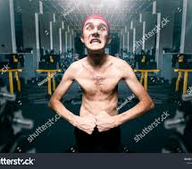
Today’s Topic: Fitness
How many times do you exercise per week?
3-4 times a week
Never
I enjoy sleeping
1-2 times a week

Slide 3
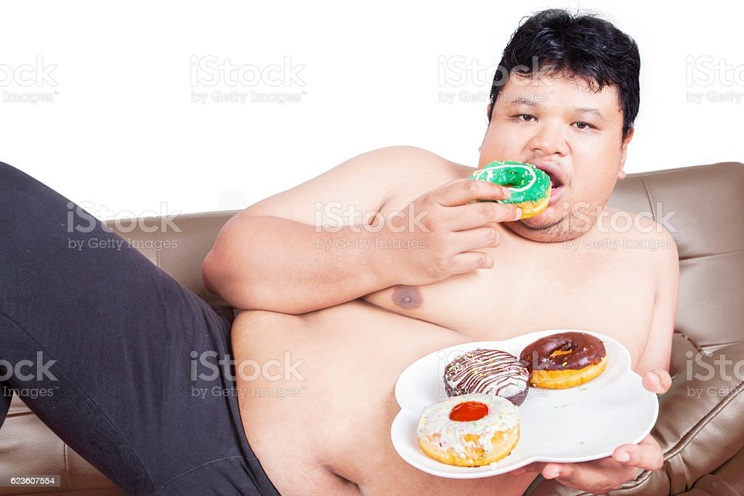
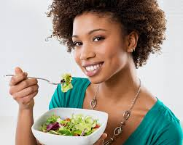
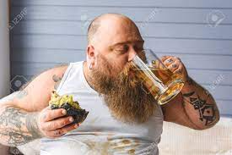
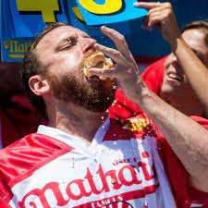
which one OF THESE PICTURES IS Healthy living?
A
C
D
B

Slide 4
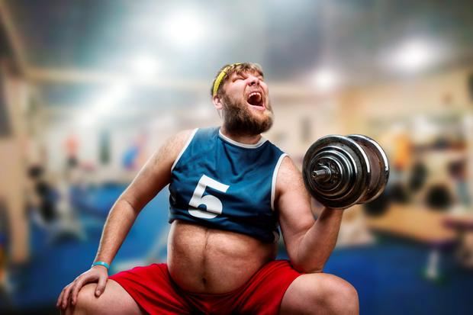
How has Fitness Helped you?
For example:
Fitness has helped me by Reducing my stress

Slide 5
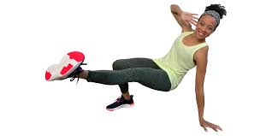
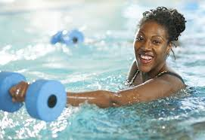
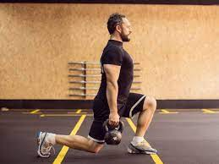
How do you plan to improve your health?

Slide 6
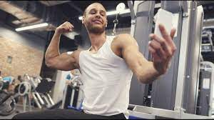
Game #1: Create a Story Your superpower is the ability to make people sing, dance and jump randomly. You notice that every time you go to the gym, there is a certain person that bully’s and pushes people out of his way. Create a funny story on how you would take care this person. Each Breakout room will have a different set of powers?

Slide 7
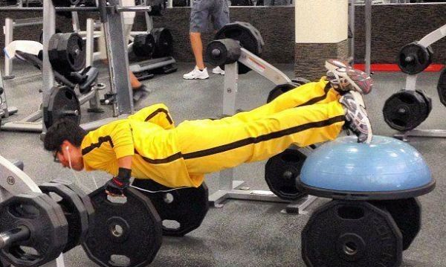
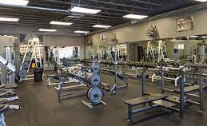
Game #1
After having encountered this induvial at the gym, I decided to put a stop to his garbage. One day, I got to the gym before him. I waited for him at a distance. When he entered the gym, and as many saw him enter, I decided to then release my powers. I first started with him jumping. Upon that, everyone started laughing as the bully jumped uncontrollably. Immediately following this, I threw him my other powers of singing and dancing, to which he danced, “beat it” from Michael Jackson. People once again, laughed and took pictures. The bully could not take this humiliation and left. Moreover, this act was posted everywhere on the internet. The bully never returned.

Slide 8
Game #2: In this game you will create a fitness plan for yourself
Exercises Food(s) Days of the week Running Vegetables Monday
Walking Spaghetti Tuesday Weightlifting Avocado Wednesday
Hotdog eating contest Chicken Thursday
Beer Drinking Pizza Friday
Polka Dancing Saturday
Sunday

Slide 9
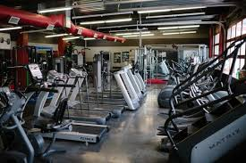
Fitness Plan
Days of the Week | Food for the day | Exercises
Monday | Pizza | Running
Tuesday
Wednesday
Thursday
Friday
Saturday
Sunday

Slide 10
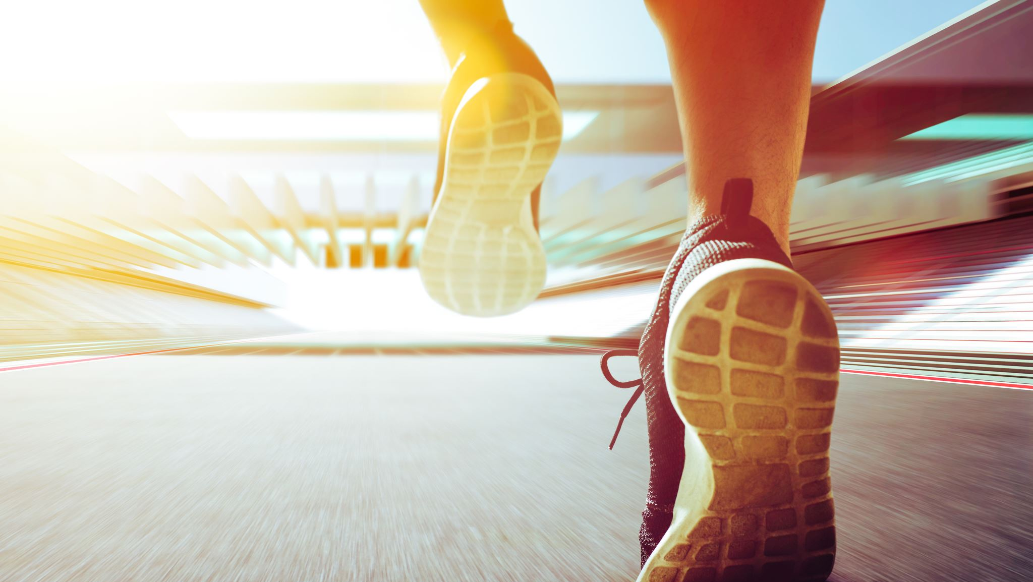
EXIT TICKET
What’s one change I can make to improve the way you learn in this class?

