Slide 1
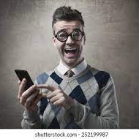
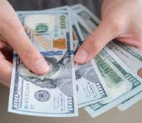
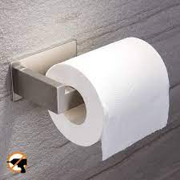
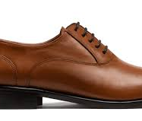
TESL-3050-November 22nd
Todays Topic is about something we use everyday. Can you guess?

Slide 2
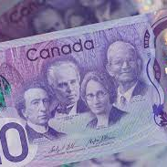
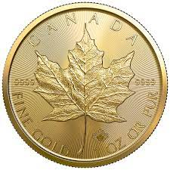
Today’s Topic is about?
$Money$

Slide 3
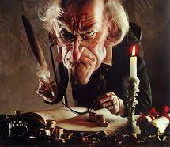
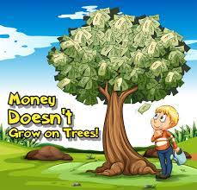
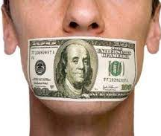
Warm-up game :Money and Figurative Language determine the meaning of each saying!
Money doesn't grow on trees.
Put your money where your mouth is.
Money makes the world go round.
A penny for your thoughts.
A penny pincher.

Slide 4
Warm-up game :Money and Figurative Language determine the meaning of each saying!
All that glitters is not gold
Meaning:
Not as good as it is
Someone or something may not be as good or as valuable as they first appear.

Slide 5
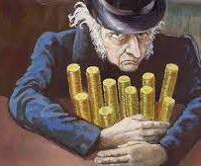
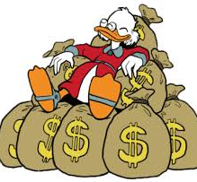
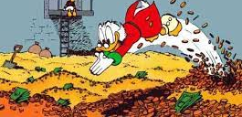
What are your plans for your financial future?
A. Savings
B. Investment instruments-Stocks, bonds,
C. Gold/Silver/Jewellery
D. Insurance
E. Hide Money under your bed

Slide 6
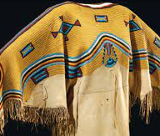
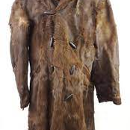
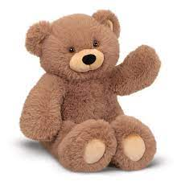
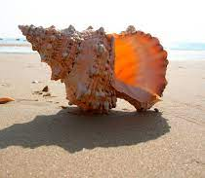
$Money Trivia$
Which of these was not an early form of money?
A. Shells
B. Beads
C. Fur
D. Teddy Bears

Slide 7
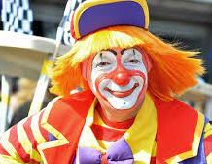
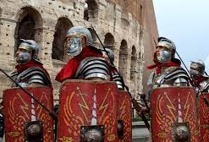
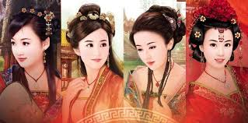
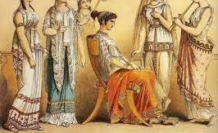
Which group was the first to use coins?
Romans
Greeks
Chinese
Clowns
Lydians

Slide 8
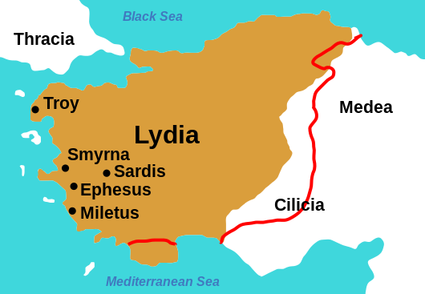
Who where the Lydians?
The Lydians (known as Sparda to the Achaemenids, Old Persian cuneiform ) were Anatolian people living in Lydia, a region in western Anatolia, who spoke the distinctive Lydian language, an Indo-European language of the Anatolian group.

Slide 10
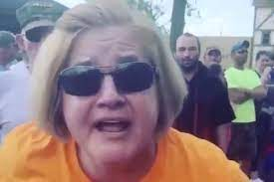
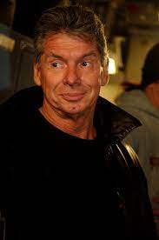
Game #1: You won the Lotto
You recently won the Lotto worth $25 Million Dollars. However, prior to wining you always had a terrible relationship with a certain neighbour called Karen and your boss Federico Jackass. Now its payback! With your team tell the class a funny story on how you would get back at Karen and Federico Jackass.
Karen
Federico

Slide 11
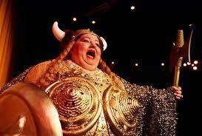
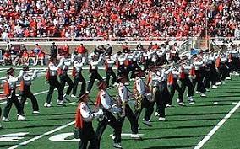
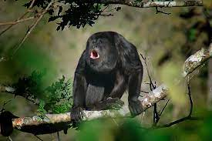
Game #1: You won the Lotto
Finally, my dream had come true. I never have to work again. But now its payback. Currently living in an apartment, and unbeknownst to Karen, I bought the apartment and rented it to members of a marching band, a group of howler monkeys and opera singers. I then bought the house to the left and right of my boss and hired the band and the howler monkeys to come everyday to practice from 1:00 am to 4:00 am. In the meantime, I lived in Hawaii
Federico
Karen

Slide 12
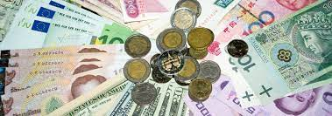
Matching Game: Match the County to its Currency
Russia Naira
Japan Dong
Vietnam Peso
Nigerian Ruble
Chilean Yen

Slide 13
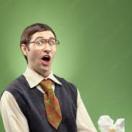
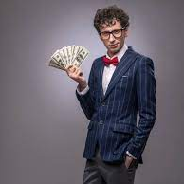
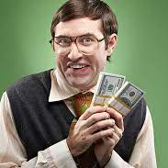
Exit Ticket
What financial advice do you have for the class?

