Slide 1
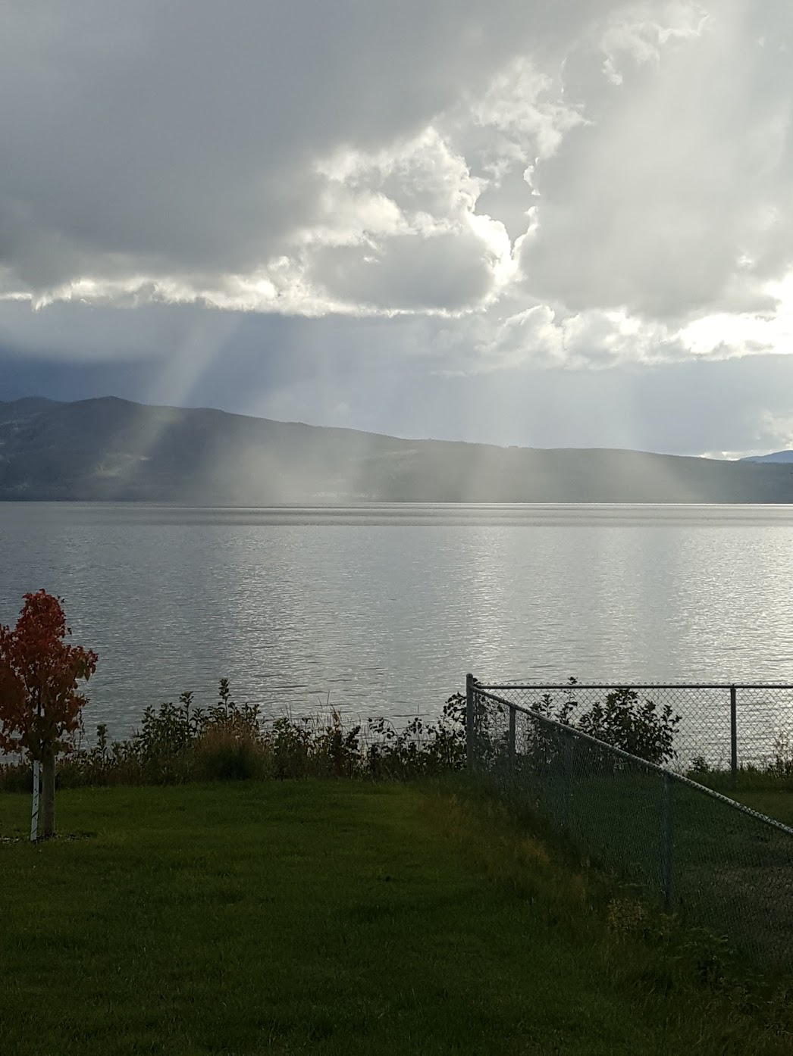
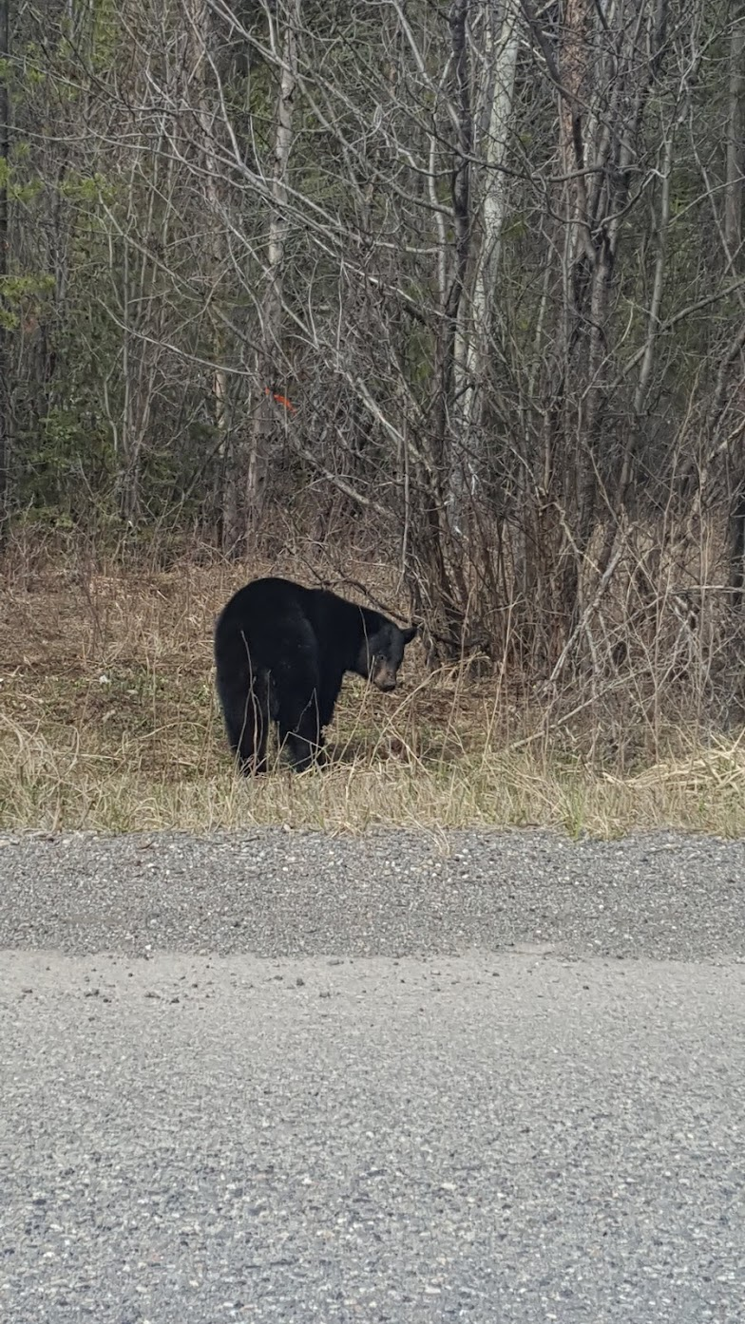
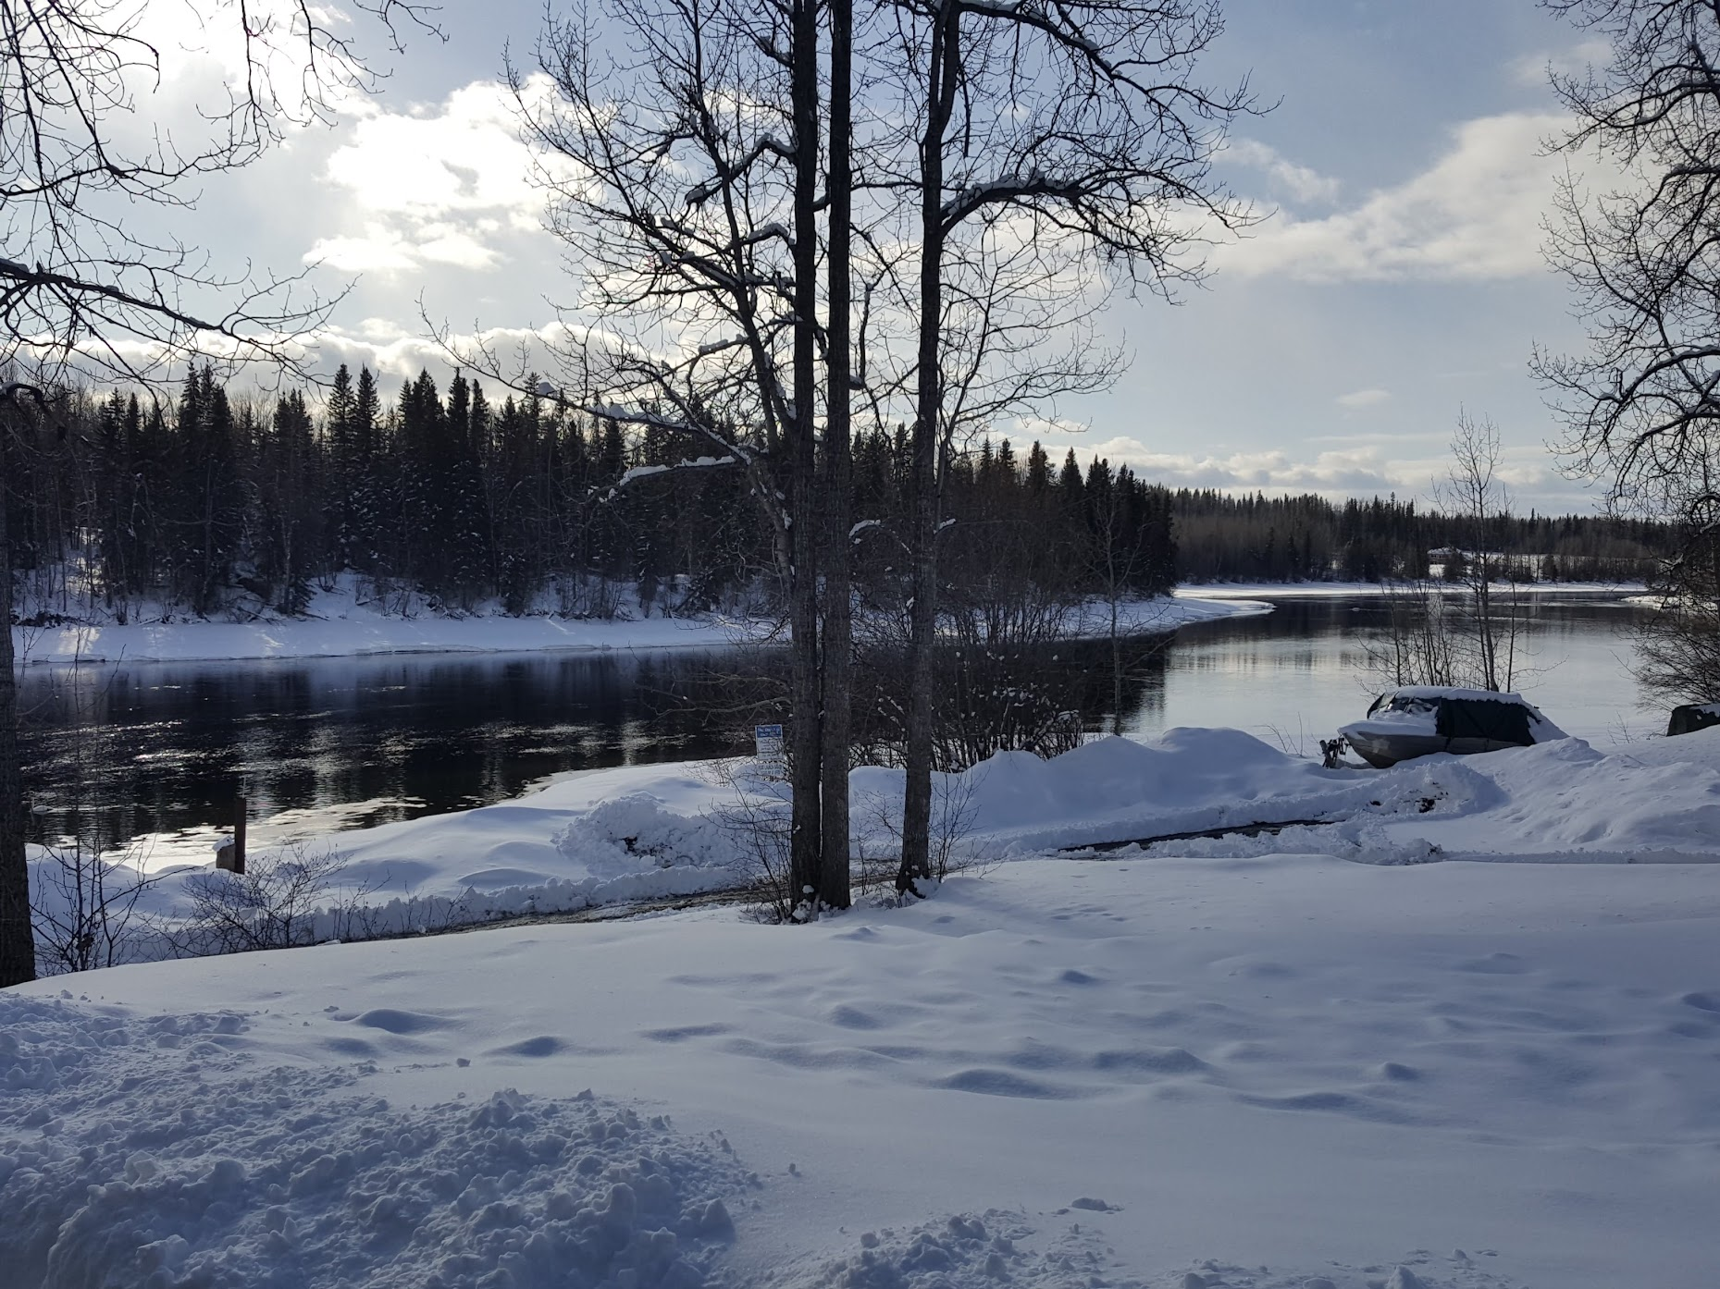
TESL 3050-Conversation CLUB
Pre-Conversation Club Talk

Slide 2
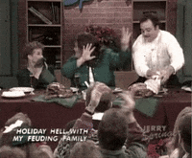
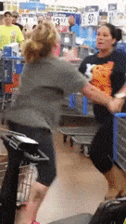
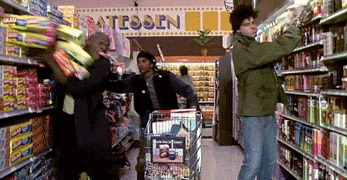
Conversation Club October 25th
Todays Topic:
Shopping

Slide 3
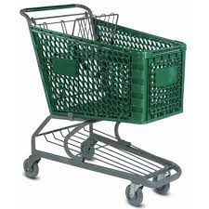
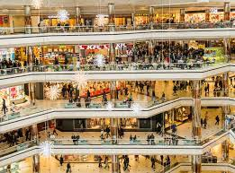
Warm-up Activity- Word Association
Think of a word you associate with the word below and why
Money
Hints
S_O_ _IN_

Slide 4
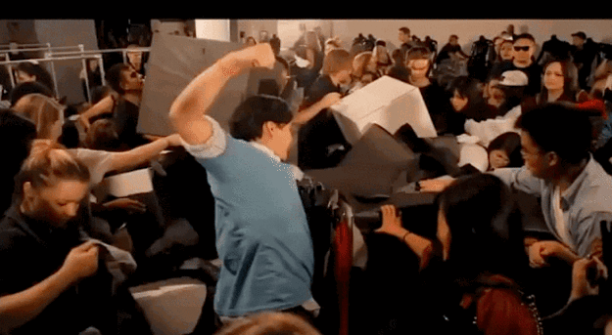
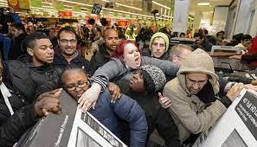
Do you like Shopping?
What is your favourite thing to shop for?
What differences do you notice from Shopping here vs your home country?
Think about the most expensive thing you have ever bought. Was it worth what you paid for it?
Do you prefer to shop alone, with your friends or family?

Slide 5
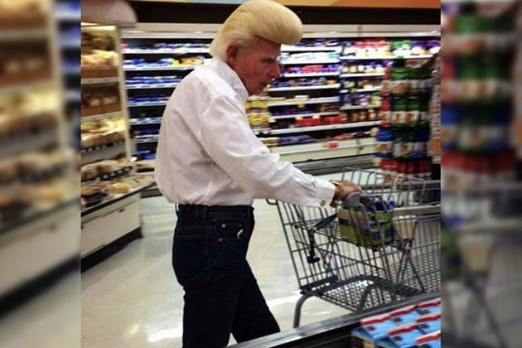
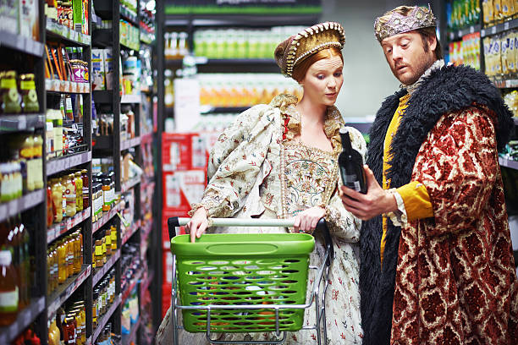
Polling Question
A- Close and personal
B-Stylish
C-The Civilized
D-Plain Savage
Which Shopper are you?
What things annoy you about other shoppers?

Slide 6
Shopping Trivia
Which Country has the biggest Shopping Mall in the world?
A. Canada
B. USA
C. United Arab Emirates
D. Saudi Arabia

Slide 7
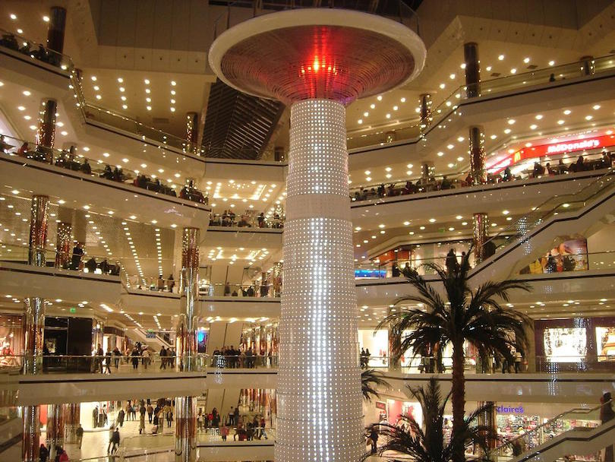
Shopping Trivia

Slide 8
Shopping Trivia
How old is the first customer complaint
A. 1980 by a guy called Clark Griswold
B. After the first Hamburger was served at McDonalds
C. 4000 thousand years ago
D. 1950

Slide 9
Shopping Trivia
The oldest customer service complaint was written on a clay cuneiform tablet in Mesopotamia 4000 years ago. (In it, a customer named Nanni complains that he was sold inferior copper ingots.)

Slide 10
Shopping Trivia
When was the first shopping catalogue published?
A. 1400’s
B. 1985
C. 30 BC
D. 79 AD

Slide 11
The first shopping catalog appeared way back in the 1400s, when an Italian publisher named Aldus Manutius compiled a handprinted catalog of the books that he produced for sale and passed it out at town fairs.

Slide 12
Shopping ETIQUETTE Questions
If you are pushing your cart, you should?
A. Ram it into other people's carts
B. Get into the cart, and ask people to push you while wearing a baby costume
C. Be boring and simply normal
D. Walk backwards while singing

Slide 13
GAME: at the Shop
With your partner, create a small conversation for buying something at the grocery store? You can see the example below. Share with the class.
Each person needs to contribute two sentences.
Customer: | I’d like some apples, please.
Shop Assistant: | What Apples would you like: green, red or yellow?
Customer: | Green, please.
Shop Assistant: | How many apples would you like?
Customer: | Can I have 5 apples?
Shop Assistant: | Sure!

Slide 14
Shopping ETIQUETTE Questions
If you're in a line up, should you:
A. Push other people out of your way
B. Start talking to yourself and laugh
C. Suck your thumb
D. Wait Patiently

Slide 15
Shopping ETIQUETTE Questions
What do you do when you encounter rude shopper:
A. Organize a group of shoppers to throw them out of the store
B. Grab a handful of tomatoes and throw it at the individual
C. Simply Smile and walk the other way
D. Go to the sports section and grab a pair of boxing gloves.

Slide 16
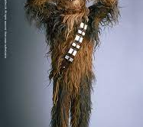
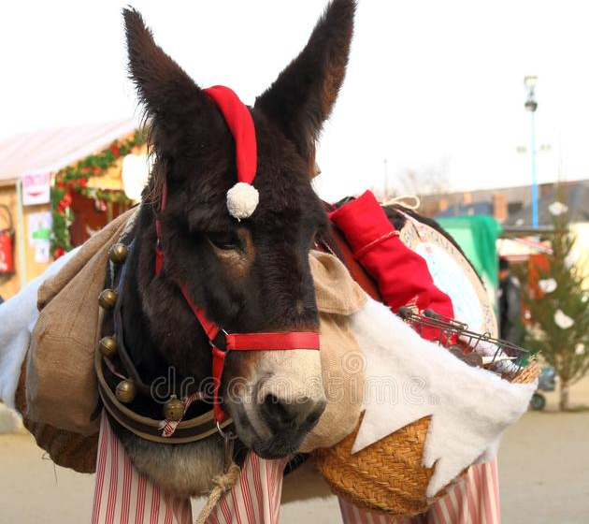
Game: You're going to a costume party with you and your mule. You need to go shopping for both of you. Describe what you would buy as a costume for both you and your mule.
Custome GAME TIME

Slide 17
Shopping ETIQUETTE Questions
If are shopping at your local supermarket, and you see your favorite actor walk in you should?
A. Scream and Holler like a wild animal
B. Start telling them you are cousins
C. Ask them to pay for your bill
D. Keep shopping

Slide 18
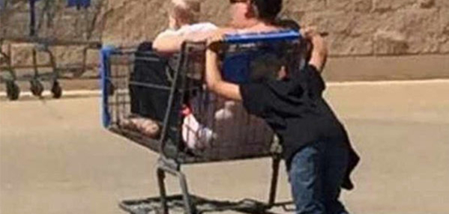
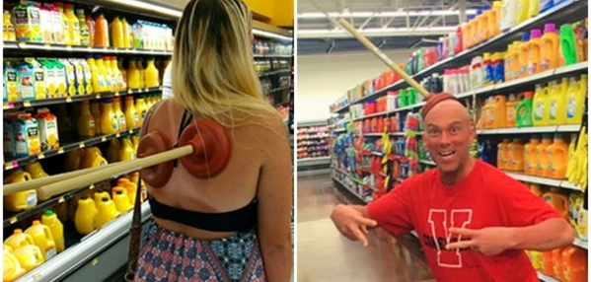
EXIT TICKET
What is one thing you learned today about shopping today?

