Slide 1
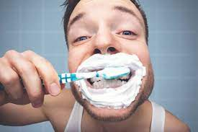
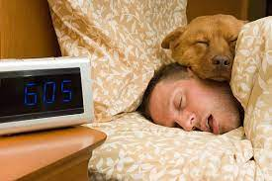
TESL-3050-Nov 15th, 2022
Todays Topic is something we do every night
Which one do you think it is?

Slide 2
Sleep
Let’s learn about sleep!
Facts of Sleep

Slide 3
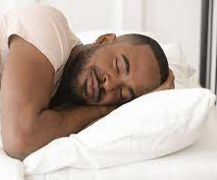
You and Your Sleep
How many hours of sleep do you get?
10 hrs.
7-9 hrs.
6 hrs.
4 hrs.

Slide 4
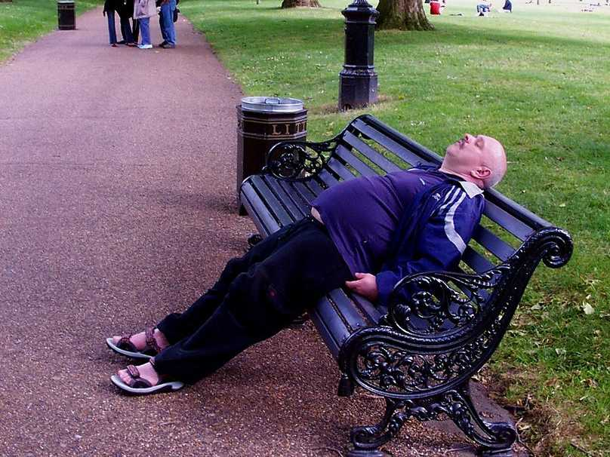
Why do you think getting a good night’s sleep is so important?

Slide 5
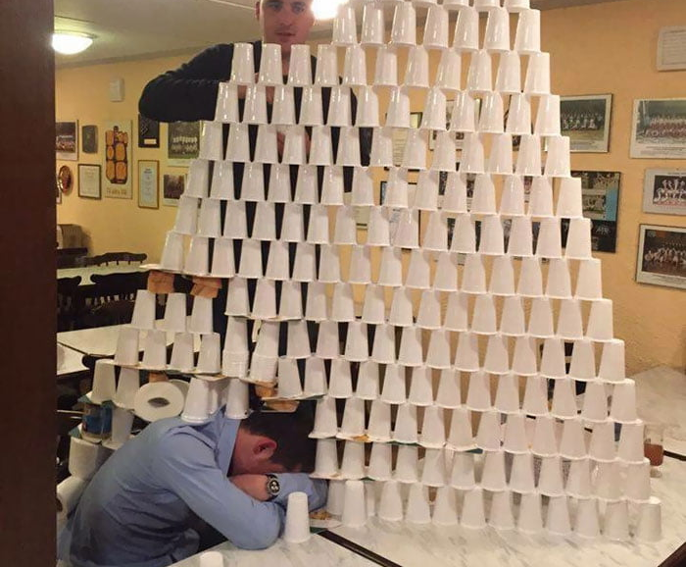
Facts of Sleep
You Need 7-9 hours of sleep
Sleep is important for our, memory,
Sleep helps strengthen your immune system
We are the only mammals that can delay sleep
Good sleep is both the amount of sleep you get in a night and the quality of your sleep.

Slide 6
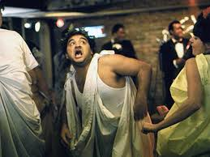
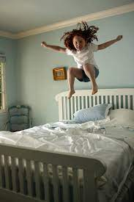
WHAT CAN YOU DO TO IMPROVE YOUR SLEEP? Use the interactive whiteboard!
GOOD
BAD

Slide 7
Game #1 Sequence of Events
During our walk, we talked about life and how things have changed throughout our lives.
By the time I was finished and headed for bed, it was 1:00 am, and I had to get up at 7:00 am for work.
At the end of the day, we had a late dinner, and headed for bed.
Prior to bed, I decided to go for a run, and clean my car.
Today my wife and I went for a long walk along the beach.
However, by the time I fell asleep, I realized it was 2:00 am.
We thought about how quickly life has passed.

Slide 8
Game #1 Sequence of Events
1. Put the paragraph in the right order
2. Do follow-up questions

Slide 9
Game #1 Follow-Up Questions
What things could I have done to get better sleep?
How many hours of sleep will I be getting?
What would you do differently?

Slide 10
Game #1 Sequence of Events
Today my wife and I went for a long walk along the beach. During our walk, we talked about life and how things have changed throughout our lives. We thought about how quickly life has passed. At the end of the day, we had a late dinner, and headed for bed. Prior to bed, I decided to go for a run, and clean my car. By the time I was finished, and headed for bed, it was 1:00 am, and I had to get up at 7:00 am for work. However, by the time I fell asleep, it was 2:00 am.

Slide 11
Game #2: Prepare a healthy sleep schedule for you and your roommate
You and your roommate always stay out late. Your roommate likes
dancing late into the night and brings his 10 friends to the room. You
like opera and sing late into the night. However, your grades in school
are starting to be affected by your lifestyle. Prepare a sleep schedule
that will improve your sleep with the information on the next slide.

Slide 12
Game #2: Prepare a healthy sleep schedule for you and your roommate
Sleep-disturbing activities | Samples of Corrective Actions
Worked until bedtime | Quit working one hour before bedtime. Set a warning alarm 1.5 hours before your typical bedtime.
Consumed alcohol within 2 hours of bedtime | Have wine with dinner and then no alcohol after that. Before bed, have some warm decaffeinated tea or milk instead of an alcoholic drink.
Did other activities (work, eating, watched TV, knitting) in bedroom | Move TV and my knitting supplies to living room or kitchen. Restrict all non-sleep activities outside of the bedroom. Store laptop in another room.
Used screens in bed immediately before bedtime | Renew subscription to Sports Illustrated and Newsweek to have hard copies to read in bed. Store laptop and cellphone in another room or across the bedroom.
Stayed in bed and worried while unable to sleep | Can’t return to sleep within 30 minutes? Get up, go to another room, and read relaxing material for at least 30 minutes – No TV!!!! Get out of bed and/or the bedroom, write down all the topics worrying you on a pad of paper, perhaps note plans for dealing with them, set aside, and return to bed. Having made a plan for problems will help keep your mind from turning them over and over whileyou are trying to sleep.

Slide 13
Game #2: Prepare Schedule and Share
Time Activity 9:00 pm Sleep
8:30 pm All electronics shut off
8:00 pm Hot bath
7:30 pm Stop working
7:00 pm Wrap up all emails
6:30 pm Supper

Slide 14
Exit Ticket
What did you learn about sleep today?

