Slide 1
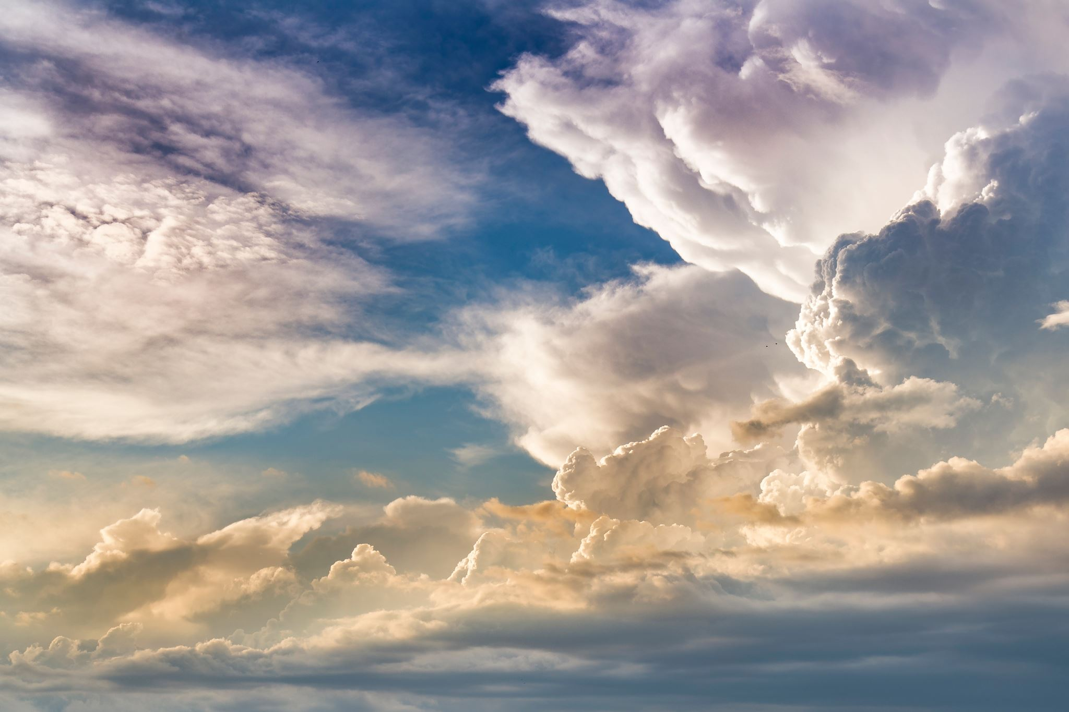
Topic: Travel
Conversation Club
Oct 18th, 2022

Slide 2
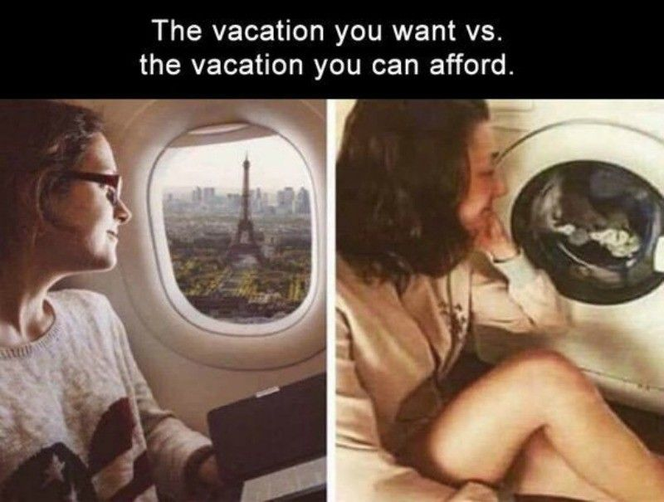
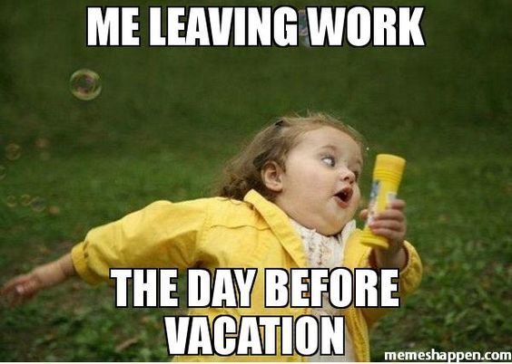
Topic: Travel
Conversation Club
Oct 18th, 2022

Slide 3
Where do you stay when you travel?
Travel polling Question
Conversation Club
Oct 18th, 2022
Hotel
friend’s/relatives'
police station
Hostel
local zOO

Slide 4
Topic: Travel
What places have you travelled to?
Why do you travel?
Tell us about a funny travel story
Where would you like to travel too next? And why?
What has been the best food you have tasted in your travels?

Slide 5
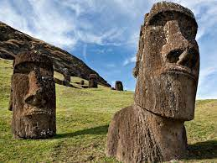
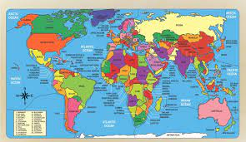
What Country do these statues come from?
Travel-Trivia

Slide 6
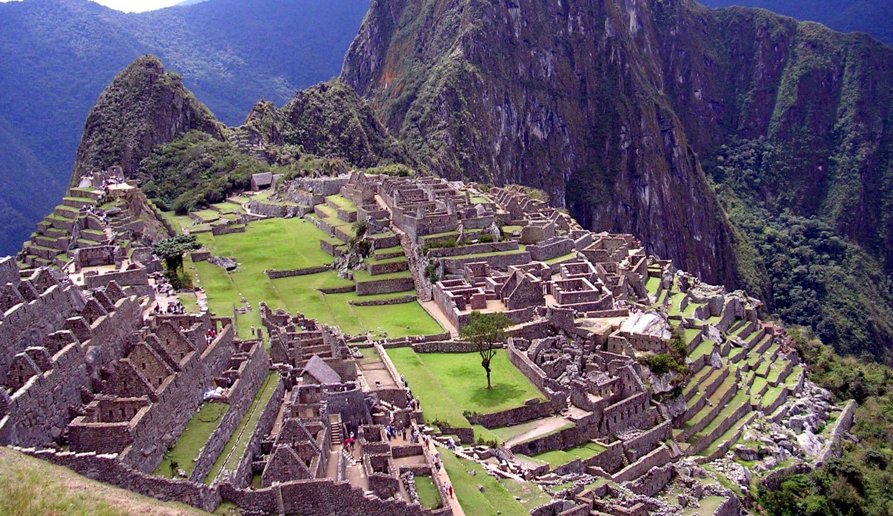
Travel Trivia
Point to the Country where this is from? And what is the name of the place? Who built it them?

Slide 7
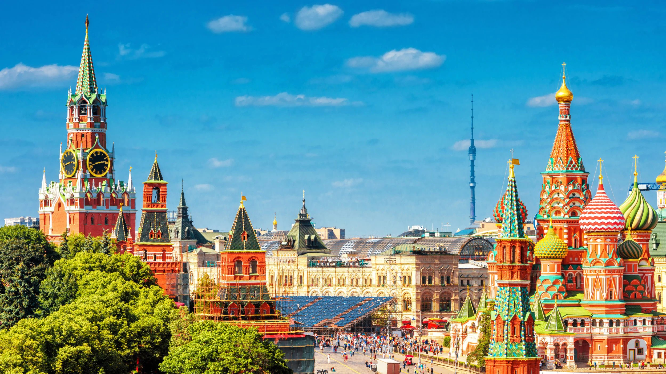
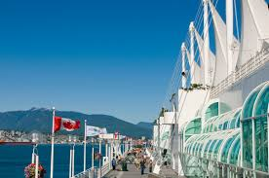
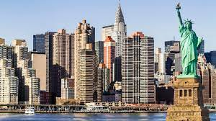
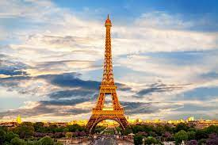
Travel Trivia
Which is the friendliest city in the world?
Why do you think its the friendliest city in the world?

Slide 8
GROUP Game: Get Across Canada
Plan A trip to Canada! Each Group has $300, PLUS THE LOCAL ITEMS BELOW- No Hitchhiking Allowed
GROUP a
GROUP b
GROUP c
Violin
Chainsaw
Maple Syrup
Beaver
Canada Goose
Moose
Snowshoes
Hiking Boots
Hockey Stick
each GROUP WILL CREATE A STORY OF HOW THEY WILL GET ACROSS Canada & share WITH THE CLASS: 10 MINS

Slide 9
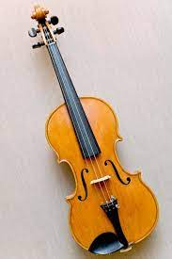
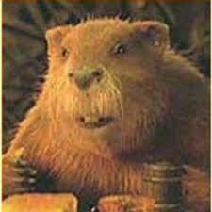
GROUP Game: Get Across Canada
Plan A trip Across Canada! No Hitchhiking Allowed
GROUP a
Title:
Violin
Example 1: Our group was able to get across Canada because our Beaver played the Violin and juggled Snowshoes.
Beaver
Snowshoes
Example 2: Our group was able to get across Canada because we played our Violin while our Beaver sang and juggled Snowshoes.
each GROUP WILL CREATE A STORY OF HOW THEY WILL GET ACROSS Canada & share WITH THE CLASS: 10 MINS

Slide 10
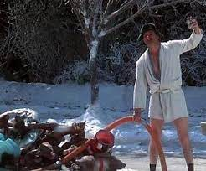
THANKYOU FOR LISTENTING

